Slide 1






Negative Yield Debt
Market Dynamics and Financial Implications
An analysis of global negative-yielding debt markets, their drivers, and implications for the financial system
2010
2014
2019
Report Date: November 11, 2025
Financial Analysis Series

Slide 2







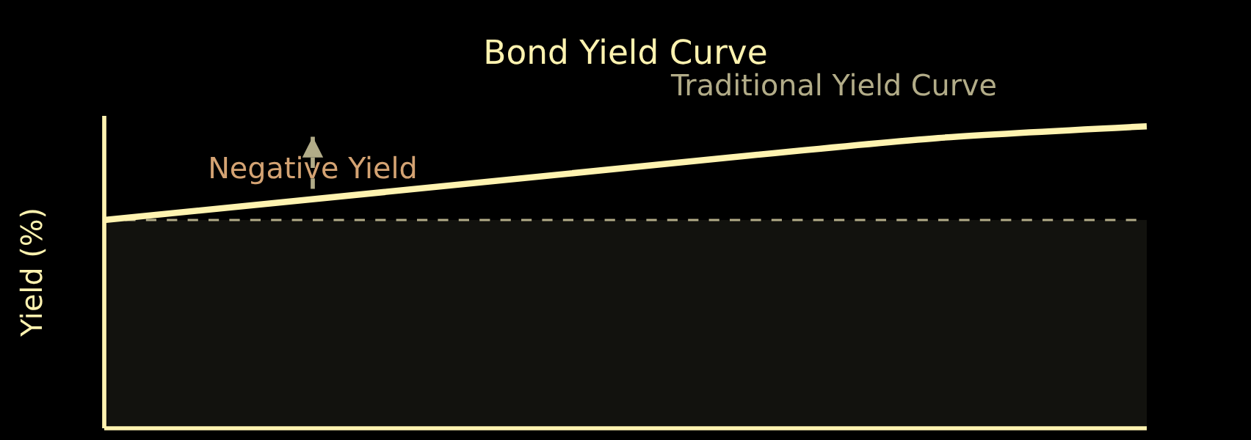




Understanding Negative Yield Debt
Definition
How It Works
Negative yield debt refers to bonds where investors receive less money at maturity than their initial purchase price, effectively paying the borrower for the privilege of holding their debt.
Purchase Price
Face Value
Net Result
$1,000
$950
-5%
An investor who buys a $1,000 bond with a 5% negative yield will receive only $950 at maturity, effectively paying $50 to keep the bond until maturity.
Key Characteristics
Yield is expressed as a negative percentage
Investors pay fees to lend money
Occurs during periods of accommodative monetary policy
Page 2 of 10
Negative Yield Debt: Market Dynamics and Financial Implications

Slide 3




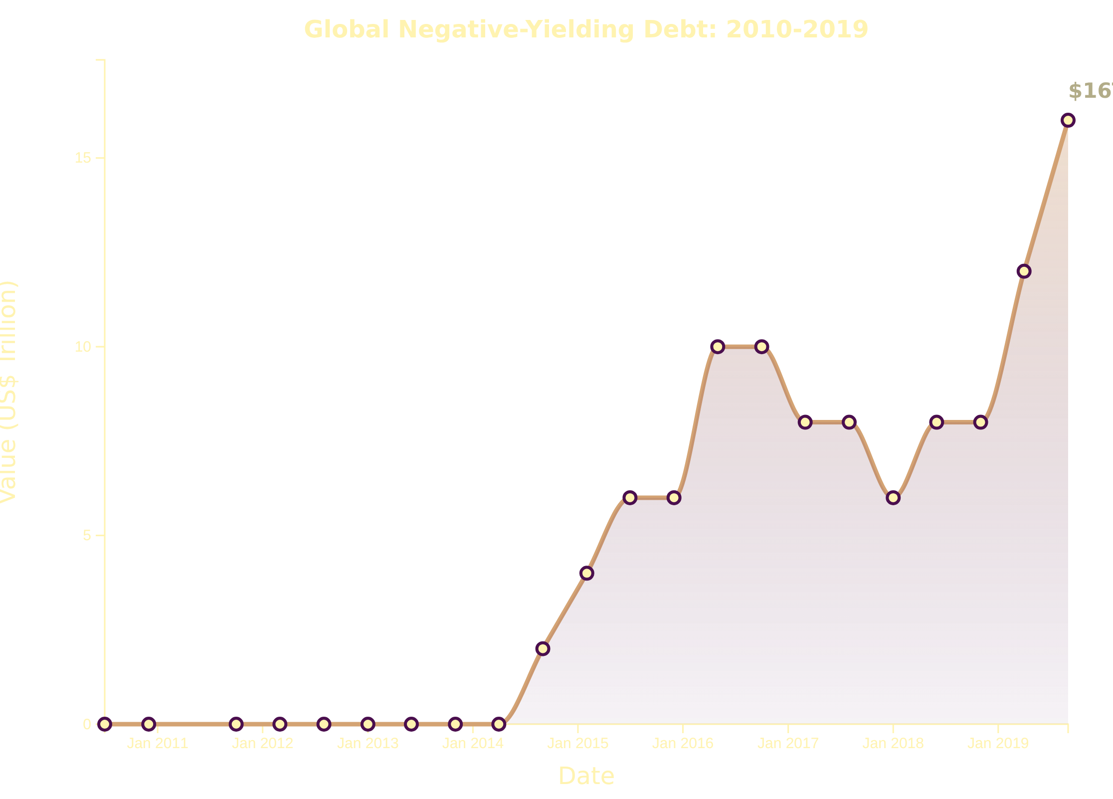







Global Scale of Negative Yielding Debt (2010-2019)
Historical Growth
The total market value of global negative-yielding debt has experienced a significant surge over time, reaching unprecedented levels. This growth reflects a period of extraordinary monetary policy and economic conditions.
Key Insights
Rapid Increase
Significant growth began in 2014, with negative-yielding debt jumping from $0 to $2 trillion by September.
Global Impact
By August 2019, the sum total reached $16 trillion, with approximately $15 trillion of government bonds traded at negative yields.
Market Share
By August 2019, nearly 25% of the global government bond market traded at negative yields, almost tripling since October 2018.
Source: Bloomberg, Quay Global Investors (Bennelong Funds, 2019)
Page 3 of 10
Negative Yield Debt: Market Dynamics and Financial Implications

Slide 4





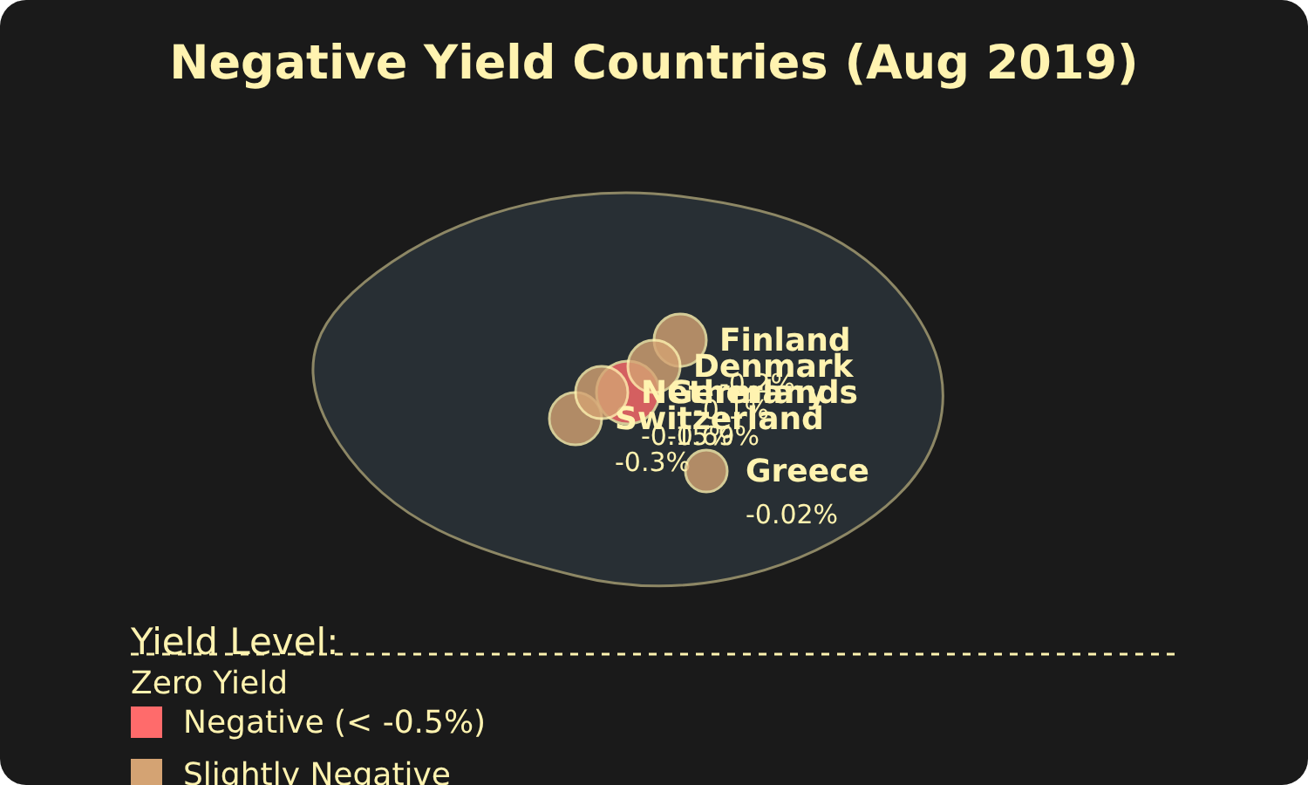



Geographic Distribution of Negative Yields
Country-Specific Yield Curves
Negative Yield Countries (Aug 2019)
Country
Maturity
Yield
Germany
10 years
-0.69%
Germany
30 years
-0.11%
Switzerland
All maturities
Below 0
Finland
All maturities
Below 0
Denmark
All maturities
Below 0
Netherlands
All maturities
Below 0
Greece
3 months
-0.02%
Key Insights
By August 2019, entire yield curves of Switzerland, Germany, Netherlands, and Finland had moved below zero
Even Greece, once the epicenter of the eurozone debt crisis, issued a three-month bond with a negative yield
This widespread negativity across maturities indicates a significant shift in investor expectations
Source: CNBC, Schroders, Reuters (2019)
Page 4 of 10
Negative Yield Debt: Market Dynamics and Financial Implications

Slide 5
















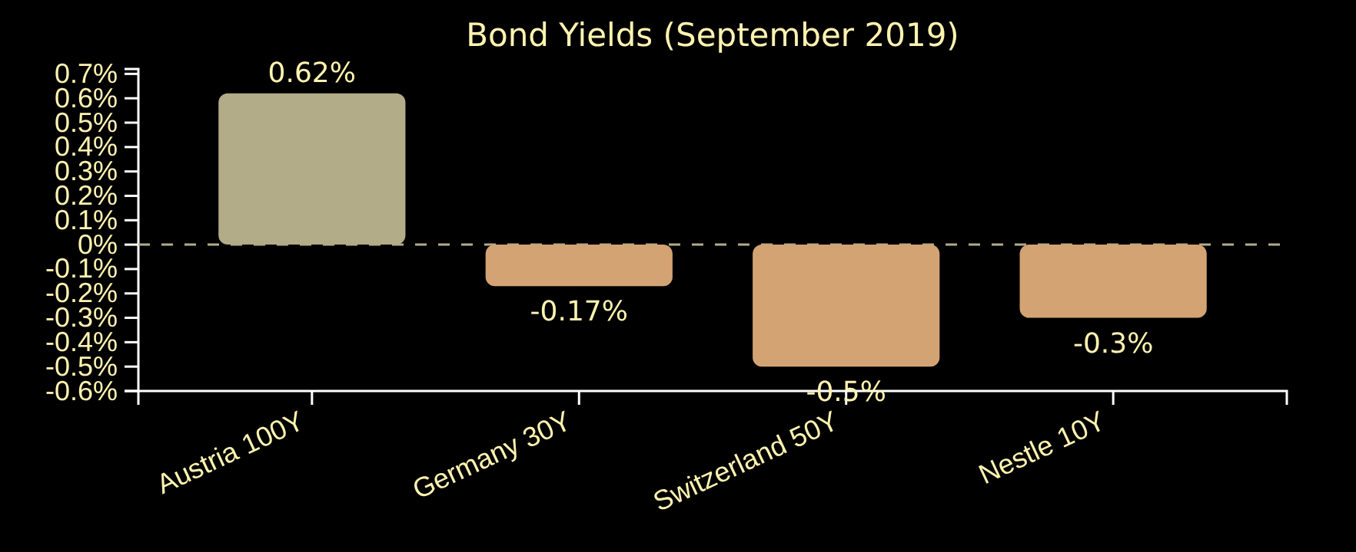
Ultra-Long-Term Bond Examples
Extreme cases of negative yields extending to century-long maturities demonstrate investor behavior in a low-yield environment.
Austria's 100-Year Bond
100-Year Maturity
Germany's 30-Year Bond
30-Year Maturity
Issued September 2017
Issued August 2019
Initial yield: 2.1%
Initial yield: -0.11%
Yield as of Sep 2019: 0.62%
Historic first negative 30-year issuance
Total Return YTD: >60%
Yield as of Sep 2019: -0.17%
Additional Examples
Yield Comparison (Sep 2019)
Switzerland's 50-Year Bond
August 2019
Below 0%
All maturities below zero
Nestle's 10-Year Corporate Bond
November 2017
Below 0%
First on-record corporate bond below zero yield
Page 5 of 10
Negative Yield Debt: Market Dynamics and Financial Implications

Slide 6


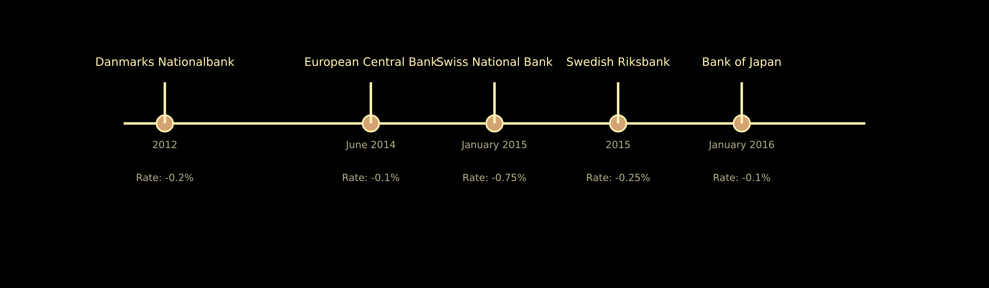






Central Bank NIRP Implementation Timeline
Negative Interest Rate Policy (NIRP) adoption by major central banks since 2012, aimed at stimulating economic activity and combating deflationary pressures.
European Central Bank
Danmarks Nationalbank
Swiss National Bank
Swedish Riksbank
Bank of Japan
Implementation: January 2016
Implementation: June 2014
Implementation: 2012
Implementation: January 2015
Implementation: 2015
Initial Rate: -0.1%
Initial Rate: -0.2%
Initial Rate: -0.25%
Initial Rate: -0.1%
Initial Rate: -0.75%
Key Insights
Denmark was the first to implement NIRP in 2012
Switzerland had the most negative initial rate at -0.75%
Page 6 of 10
Negative Yield Debt: Market Dynamics and Financial Implications

Slide 7





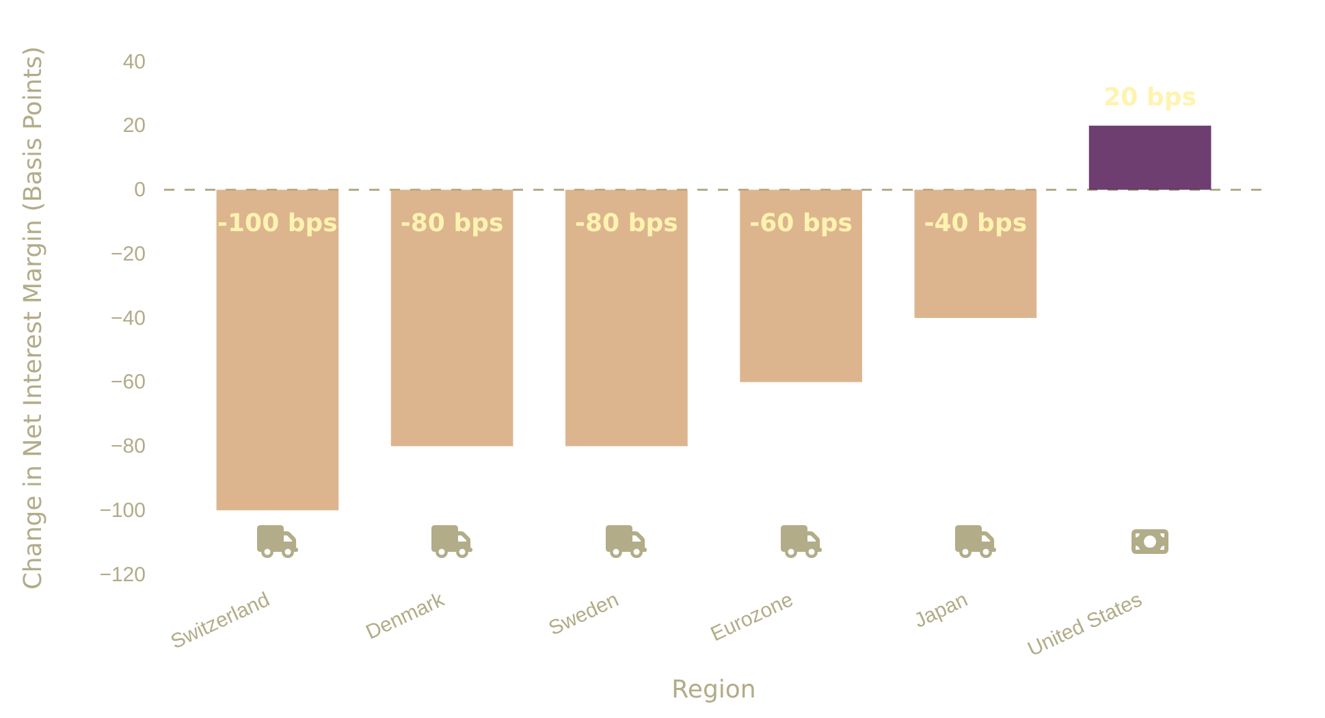


Impact on Banking Sector Profitability
NIM Compression
Change in Net Interest Margin (2014–2019)
Negative Interest Rate Policies (NIRP) have compressed Net Interest Margins (NIM) in regions where they were implemented, as banks cannot fully pass negative rates to retail depositors.
This has reduced banking system profitability and altered business models across affected regions.
Key Insights
Switzerland experienced the largest NIM decline (-100 basis points)
Source: Company filings, OCC Economics Department calculations, Bloomberg (OCC, 2021)
Denmark and Sweden also saw significant compressions (-80 bps each)
United States, which didn't implement NIRP, saw a 20 basis point increase in NIM
Page 7 of 10
Negative Yield Debt: Market Dynamics and Financial Implications

Slide 8









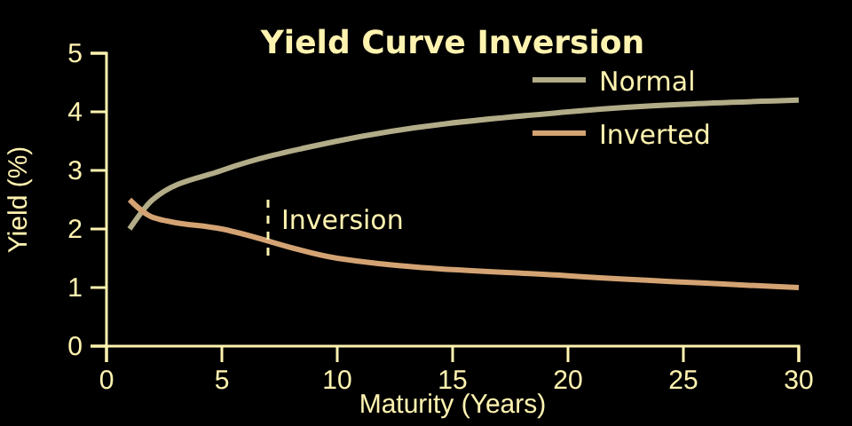




Financial System Distortions
Search for Yield
Yield Curve Inversion
Portfolio Shifts
Investors move into riskier asset classes to achieve desired returns.
Investors shift allocations to maintain yield targets.
Inversion signals market apprehension about future growth.
Increased valuations in credit products, equities, and private markets
Increased risk-taking restores prospective returns
Historical recession predictor
Global negative yields exacerbate inversion
Regulatory requirements compel negative-yield purchases
Pension funds and insurance companies accept diminished returns
The "search for yield" phenomenon describes how investors are compelled to move into riskier asset classes.
Key Risk:
Increased volatility
Page 8 of 10
Negative Yield Debt: Market Dynamics and Financial Implications

Slide 9







Investor Rationale for Negative Yield Purchases
Despite counterintuitive returns, investors purchase negative-yielding bonds for several strategic reasons beyond traditional income generation.
Safety & Capital Preservation
Price Appreciation Expectation
In times of uncertainty, government bonds are perceived as safe-haven assets. Investors accept negative yields to protect principal from greater losses in riskier assets.
If investors anticipate rates will fall further into negative territory, bond prices will rise. They can sell before maturity for a profit, even if holding to maturity would result in a loss.
Currency Hedging/Appreciation
Regulatory/Mandate Requirements
Investors might buy negative-yielding bonds denominated in another currency if they expect that currency to appreciate, offsetting the negative yield or generating a positive return.
Institutional investors like pension funds are often mandated to hold certain proportions of highly-rated, liquid government bonds, regardless of yield. These requirements compel them to purchase negative-yielding debt.
Sources: Schroders, RBC GAM, NEAM Group, CFI, CNBC, PortfolioConstruction Forum
Page 9 of 10
Negative Yield Debt: Market Dynamics and Financial Implications

Slide 10


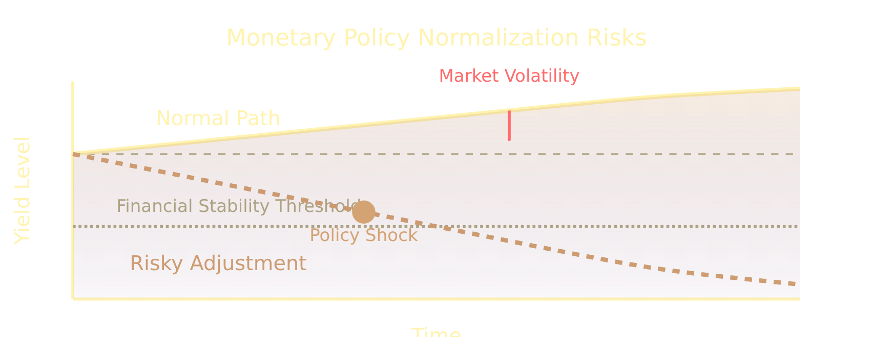














Future Outlook and Policy Normalization Risks
Long-term Persistence Factors
Aging Demographics
Increasing population age profiles in developed economies boost saving rates
Low Productivity Growth
Structural factors limiting economic output per worker
Global Savings Glut
Excess global savings over investment opportunities
Future Trajectory
Policy Normalization Risks
The future path of negative yields depends on:
Market volatility if yields rise too quickly
Impact on heavily indebted economies
Central Bank Actions
Fiscal Policy
Global Economy
Risks to financial institution stability
Government spending and debt levels
Monetary policy normalization pace
Economic growth and inflation trends
Page 10 of 10
Negative Yield Debt: Market Dynamics and Financial Implications

